Slide 1


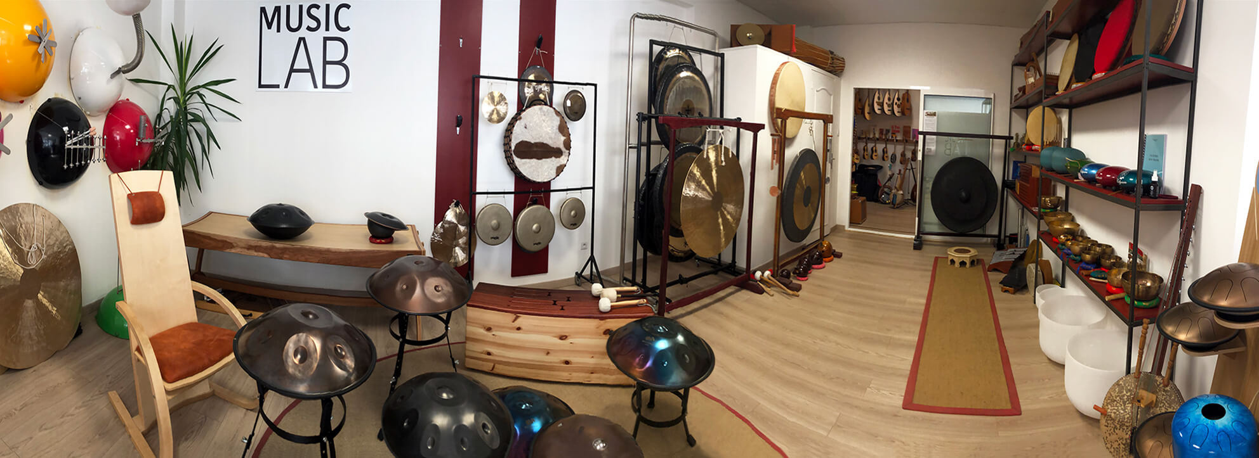
MUSIC STORE
DATA ANALYSIS
~A SQL Case Study

Slide 2
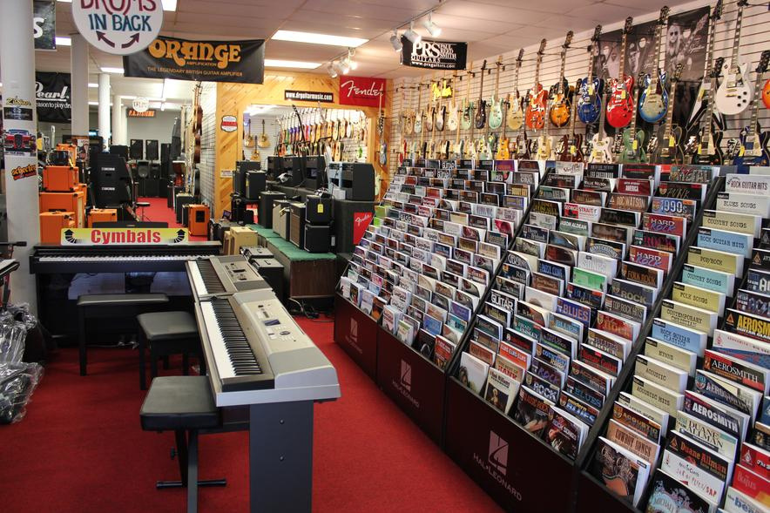
Problem Statement:
As a data analyst, harness the power of SQL to glean actionable insights from a music store's playlist dataset. Navigate through trends, unearth customer preferences, and illuminate areas for improvement. Tackle business challenges, spotlight top spenders, and distill key insights for crafting impactful offers. Your strategic analysis will drive informed decision-making, shaping the music store's path to sustained growth.

Slide 3

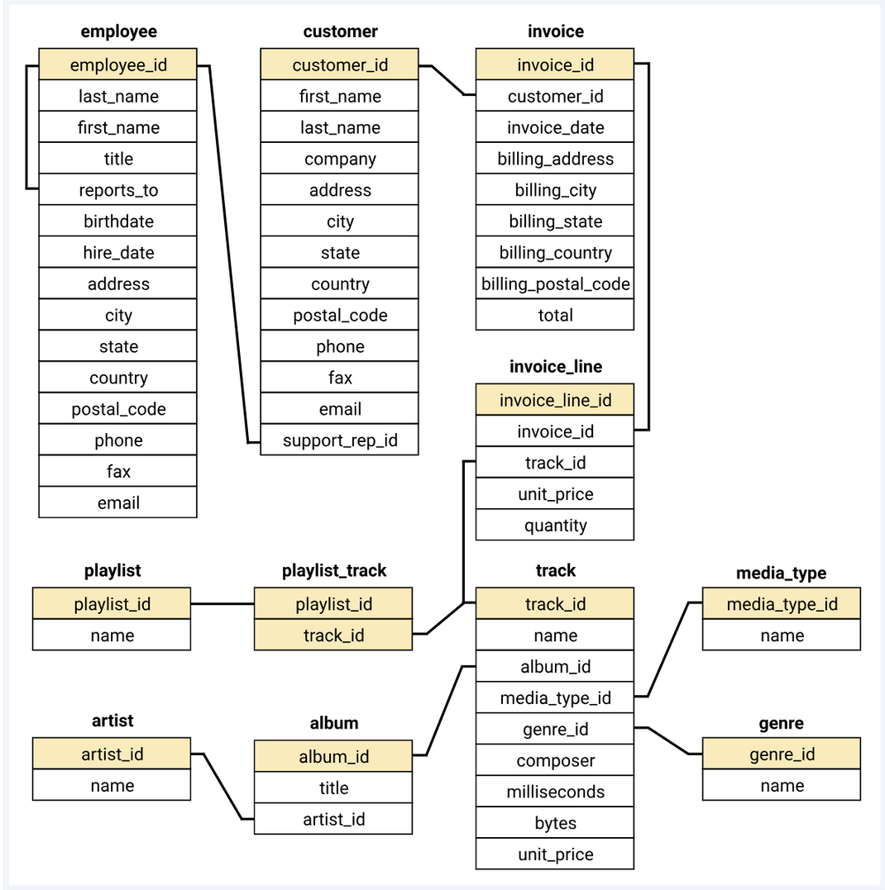
Understanding the Data Set:

Slide 4
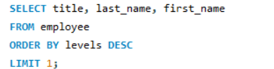
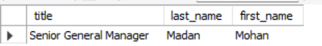
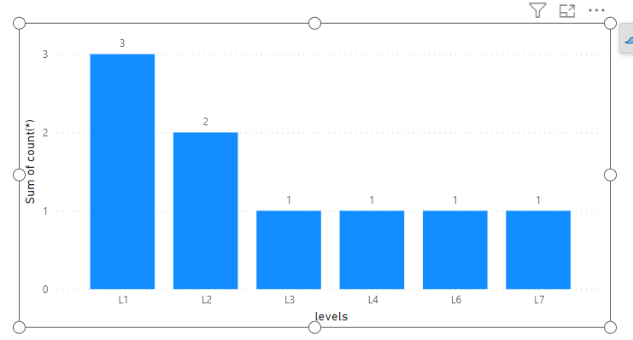
Q1: Who is the senior most employee based on job title?
Query:
Output:
Insights:
1)Clearly,Madan Mohan is the senior most employee.
2)No. of employees are less at senior level as compared to junior level

Slide 5
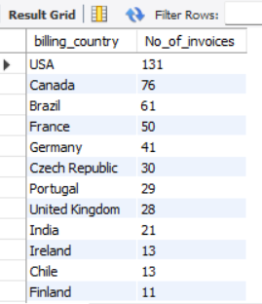
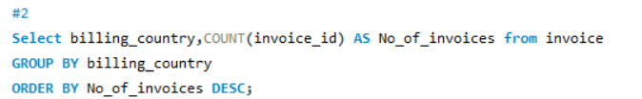
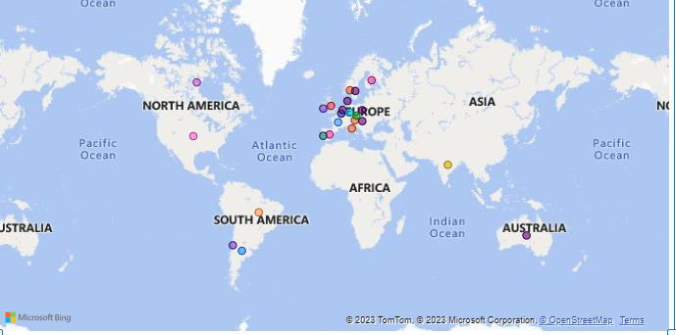
Q2: Which countries have the most Invoices?
Output:
Query:
Insights:
1)USA has the most invoices.
2)However , it can be clearly seen that Europe played a major role in invoice generation as maximum countries are european.

Slide 6
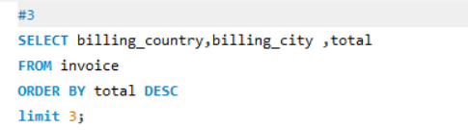
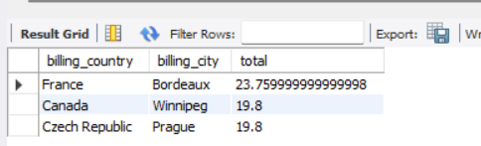
Q3: What are top 3 values of total invoice?
Query:
Output:

Slide 7
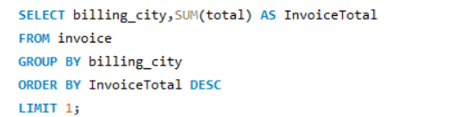
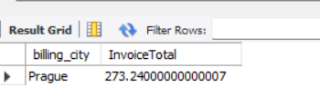
Q4: Which city has the best customers?We would like to throw a promotional Music Festival in the city we made the most money. Write a query that returns one city that has the highest sum of invoice totals. Return both the city name & sum of all invoice totals
Query:
Output:

Slide 8
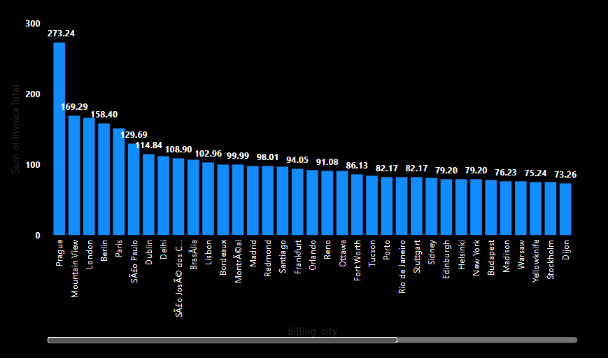
Insights:
1)Prague has has the highest sum of invoice totals.Hence, is the city with best customers.
2)The other top countries are:Mountain view,London ,Berlin and can also be considered for a promotional festival.

Slide 9
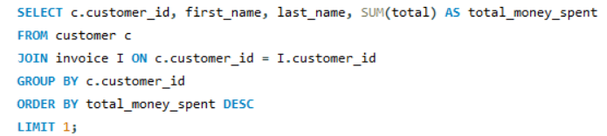
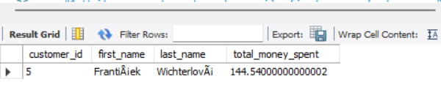
Q 5: Who is the best customer? The customer who has spent the most money will be declared the best customer. Write a query that returns the person who has spent the most money.
Query:
Output:

Slide 10
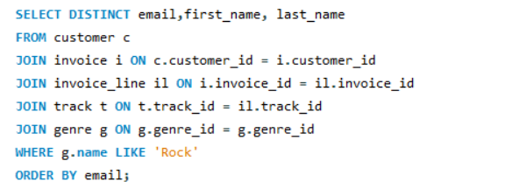
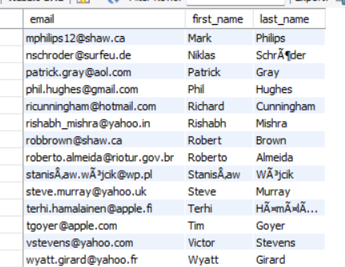
Q 6: Write query to return the email, first name, last name, & Genre of all Rock Music listeners. Return your list ordered alphabetically by email starting with A.
Query:
Output:

Slide 11
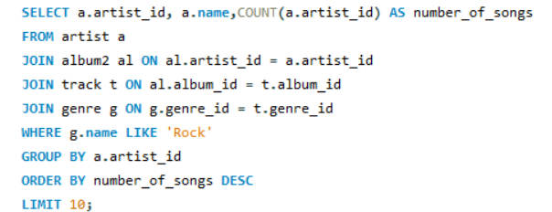
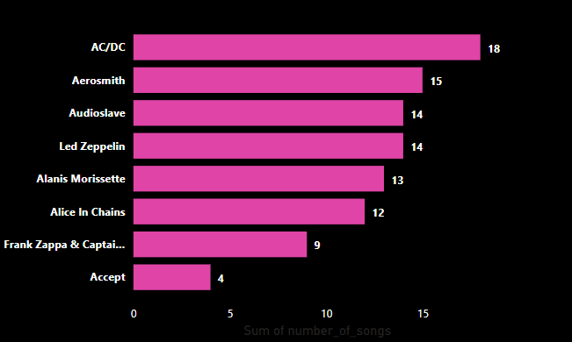
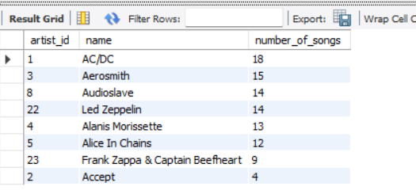
Q7: Let's invite the artists who have written the most rock music in our dataset. Write a query that returns the Artist name and total track count of the top 10 rock bands
Query:
Insights:
1)CLearly, AC/DC is the artist who have written the most rock music followed by Aerosmith
Output:

Slide 12
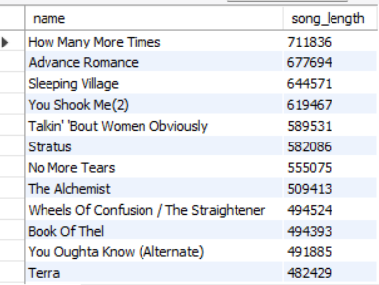
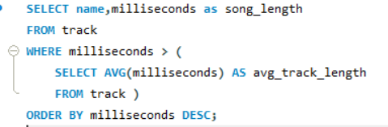
Q8: Return all the track names that have a song length longer than the average song length. Return the Name and Milliseconds for each track. Order by the song length with the longest songs listed first.
Output:
Query:

Slide 13
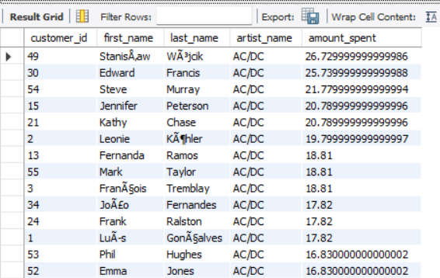
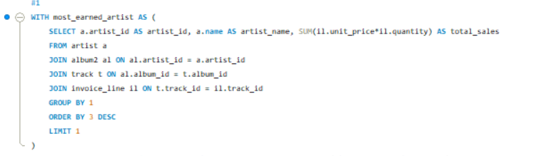
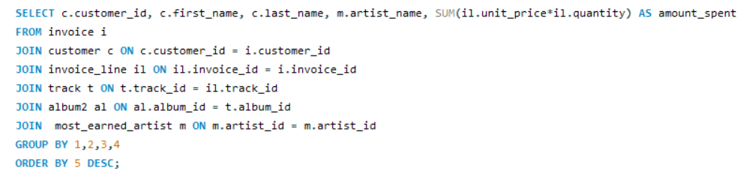
Q9: Find how much amount spent by each customer on artists? Write a query to return customer name, artist name and total spent.
Query:
Output:

Slide 14
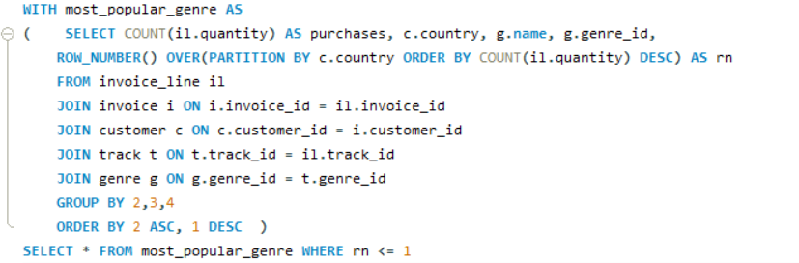
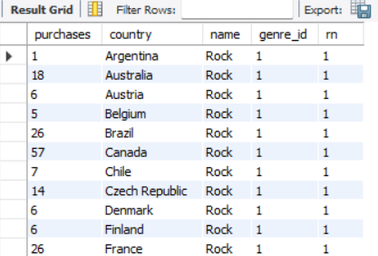
Q10: We want to find out the most popular music Genre for each country. We determine the most popular genre as the genre with the highest amount of purchases. Write a query that returns each country along with the top Genre. For countries where the maximum number of purchases is shared return all Genres.
Query:
Output:
Insights:
1)Rock is the most popular Genre

Slide 15
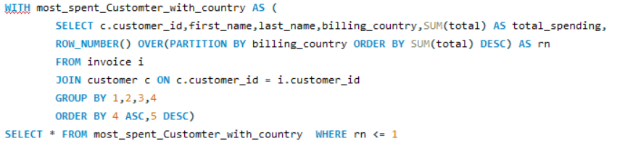
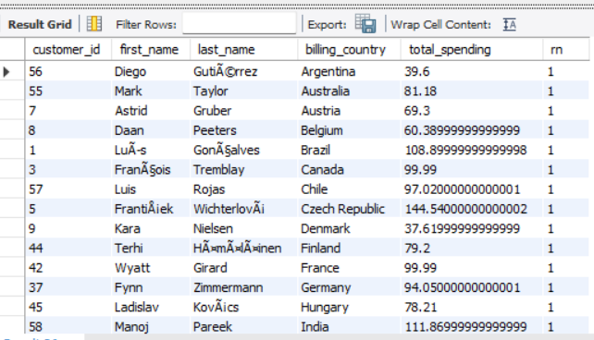
Q.11:Write a query that determines the customer that has spent the most on music for each country. Write a query that returns the country along with the top customer and how much they spent. For countries where the top amount spent is shared, provide all customers who spent this amount
: Query
Output:

Slide 16
CONCLUSIONS:
1)Employee Hierarchy Gap:There are fewer employees at the senior level as compared to the junior level
2)Customer Demographics:
The USA dominates in invoice count, but the pivotal role of Europe is evident, with a majority of customers (approximately 70%) stemming from European countries.
3)Popular Music Genre: Rock
4)Top Rock Artist : AC/DC
5)Top invoice generator city: Prague emerges as the city with the highest total invoice sum.
Other top contributors include Mountain View, London, and Berlin, making them potential candidates for a promotional festival, with Prague being the first choice as top two customers who spend the most money also belong to Prague.

Slide 17
Thank
you!

